Slide 1



Vehicle Maintenance Tracker App
A smart way to track your vehicle's maintenance
Notes:
1

Slide 2
Project Overview
Introduction
Objective
The Vehicle Maintenance Tracker is an Android app designed to help users log and track vehicle maintenance efficiently. Built using Kotlin and Android Jetpack, it simplifies record-keeping and ensures users never miss a service.
Provide an easy-to-use solution for vehicle owners to track maintenance records, improving vehicle longevity and performance.
Notes:
2

Slide 3





Group Contributions
Abdul Kabeer (22SW067)
Muhammad Yashfaien
(22SW043)
Backend Development
Frontend Development
Mubashir Hussain (22SW061)
Irfan Memon (22SW122)
UI/UX Design
Idea, Project Management
Notes:
3

Slide 4
Key Features
Add & Manage Multiple Vehicles
Log Service Records
View Maintenance History
User-Friendly Interface
Day & Night Mode Themes
Offline Support
Notes:
4

Slide 5
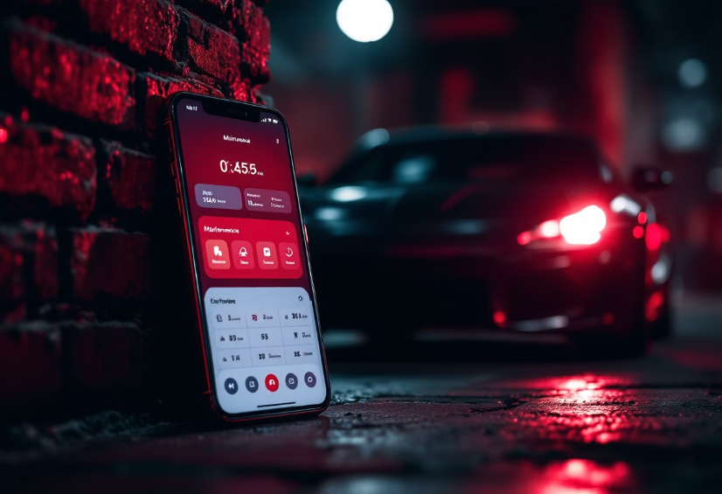
How It Works
User adds vehicle details (Make, Model, Year)
1
User logs maintenance records for the vehicle
2
The app stores and organizes service history
3
Users can access their records anytime
4
Notes:
5

Slide 6
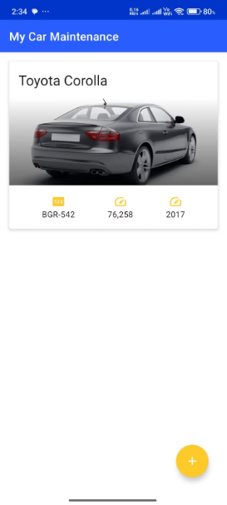
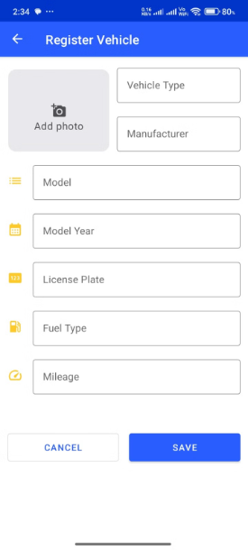
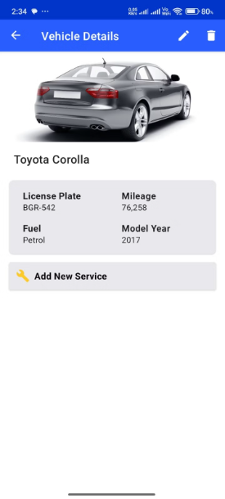
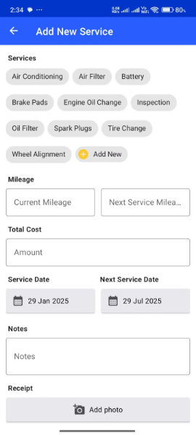
Interface of our App
Notes:
6

Slide 7
Project Timeline
1
Week 1
Research & Planning
2
Week 2, 3
UI/UX Design & Frontend Development
3
Week 4, 5
Backend Development & Database work
4
Week 6
Testing, Submission and Presentation
Notes:
7

Slide 8

Technologies Used
Programming Language
Frameworks & Libraries
Kotlin, XML
Android SDK, Gradle
Development IDE
Database
Android Studio
Room Database (SQLite)
Notes:
8

Slide 9



Challenges & Learnings
Challenges
Implementing an intuitive UI
Managing data efficiently using Room Database
Ensuring smooth navigation between activities
Learnings
Improved understanding of Android SDK libraries
Optimized database handling for performance
Better teamwork and collaboration
Notes:
9

Slide 10




Future Enhancements
Service Reminders & Notifications: Smart notifications based on vehicle mileage or time intervals for upcoming maintenance.
1
2
GPS Integration: to find nearby service centers.
3
Maintenance cost analytics: to help users track expenses.
4
Cloud Sync: So users can access data across multiple devices.
Notes:
10

Slide 11

Conclusion & Thank You
This app offers a valuable solution for vehicle owners
We look forward to implementing future enhancements
Thank you for your time and consideration
Notes:
11

